Slide 1

CSE- 321
Software Engineering
Lecture : 18-19 Testing, Quality
Fahad Ahmed
Lecturer, Dept. of CSE
E-mail: fahadahmed@uap-bd.edu

Slide 2
B | A
5 April | 6 April | Testing-2 with quality, Maintenance+ Deployment
7 April | 8 April | Security
12 April | 13 April | ct-4 (Testing with quality)
 |  | Final Viva
*Assignment-03- Quality Assurance + Testing last date 23-04-21
** Final viva: Design, Testing, Security

Slide 3


Software testing

Slide 4
Different types of testing
Regression Testing
Whenever a software product is updated with new code, feature or functionality, it is tested thoroughly to detect if there is any negative impact of the added code. This is known as regression testing.
Load Testing
Load testing is performed under system testing to clarify whether the system can work under real-time loads or not.
Stress testing
The stress testing is testing, which checks the behavior of an application by applying load greater than the desired load. Since it is non-functional testing, so we use this testing when the application is functionally stable.
Recovery Testing
Recovery testing of a system is performed under system testing to confirm reliability, trustworthiness, accountability of the system and all are lying on recouping skills of the system. It should be able to recover from all the possible system crashes successfully.
In this testing, we will test the application to check how well it recovers from the crashes or disasters.

Slide 5
Different types of testing
Migration Testing
Migration testing is performed to ensure that if the system needs to be modified in new infrastructure so it should be modified without any issue.
Usability Testing
The purpose of this testing to make sure that the system is well familiar with the user and it meets its objective for what it supposed to do.
Database Testing: Database testing is a type of testing which checks the schema, tables, triggers, etc. of the database under test. Database testing may involve creating complex queries to load/stress test the database and check its responsiveness. It checks the data integrity and consistency
Release testing the process of testing a particular release of a system that is intended for use outside of the development team. Release testing has a broad focus, since the entire functionality of the release is under test. The tests included in release testing is strongly dependent on the software itself.
Requirements-based testing
Scenario testing

Slide 6
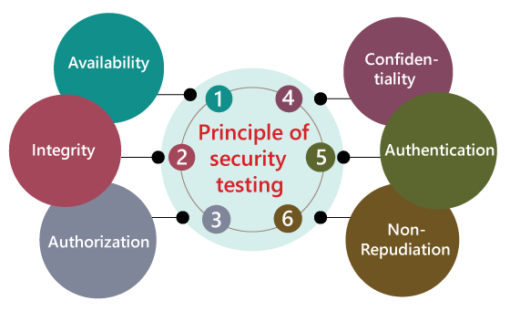
Different types of testing
Security testing
Security testing is an integral part of software testing, which is used to discover the weaknesses, risks, or threats in the software application and also help us to stop the nasty attack from the outsiders and make sure the security of our software applications.
The primary objective of security testing is to find all the potential ambiguities and vulnerabilities of the application so that the software does not stop working. If we perform security testing, then it helps us to identify all the possible security threats and also help the programmer to fix those errors.

Slide 7
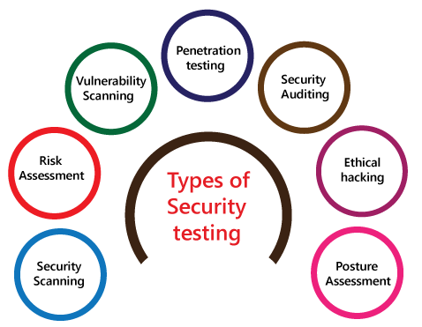
Security testing
Types of Security testing
As per Open Source Security Testing techniques, we have different types of security testing which as follows:
Security Scanning
Risk Assessment
Vulnerability Scanning
Penetration testing
Security Auditing
Ethical hacking
Posture Assessment

Slide 8
Alpha testing vs Beta testing
Alpha Testing | Beta Testing
Alpha testing performed by a team of highly skilled testers who are usually the internal employee of the organization. | Beta testing performed by clients or end-users in a real-time environment, who is not an employee of the organization.
Reliability or security testing not performed in-depth in alpha testing. | Reliability, security, and robustness checked during beta testing.
Alpha testing involves both white box and black-box techniques. | Beta testing uses only black-box testing.
Long execution cycles maybe require for alpha testing. | Only a few weeks are required for the execution of beta testing.
Alpha testing performed before the launch of the product into the market. | At the time of software product marketing.
Alpha testing focuses on the product's quality before going to beta testing. | Beta testing concentrates on the quality of the product, but gathers users input on the product and ensures that the product is ready for real-time users.
Alpha testing performed nearly the end of the software development. | Beta testing is a final test before shipping a product to the customers.
Alpha testing is conducting in the presence of developers and the absence of end-users. | Beta testing reversed of alpha testing.

Slide 9
Re-testing Vs Regression Testing
Re-testing | Regression Testing
Re-testing is performed to ensure that the test cases that are failed in the final execution are passing after the defects fixed. | Regression Testing is done to confirm whether the code change has not affected the existing features.
Re-Testing works on defect fixes. | The purpose of regression testing is to ensure that the code changes adversely not affect the existing functionality.
Defect verification is the part of the Retesting. | Regression testing does not include defect verification
The priority of Retesting is higher than Regression Testing, so it is done before the Regression Testing. | Based on the project type and availability of resources, regression testing can be parallel to Retesting.
Re-Test is a planned Testing. | Regression testing is a generic Testing.
We cannot automate the test-cases for Retesting. | We can do automation for regression testing; manual testing could be expensive and time-consuming.
Re-testing is for failed test-cases. | Regression testing is for passed Test-cases.
Re-testing make sure that the original fault is corrected. | Regression testing checks for unexpected side effect.
Retesting executes defects with the same data and the same environment with different input with a new build. | Regression testing is when there is a modification or changes become mandatory in an existing project.

Slide 10
System testing vs Acceptance testing
System Testing | Acceptance Testing
System testing is performed to test end to end functionality of the software. | Acceptance testing is performed to test whether the software is conforming specified requirements and user requirements or not.
Only developers and testers can perform System testing. | It can be performed by testers, stakeholders and costumers.
It can be both non-functional and functional testing. | It can be only functional testing.
In System testing, we test the performance of the whole system. | In Acceptance testing, we test whether the system is conforming requirements or not.
System testing uses demo input values that are selected by the testing team. | Acceptance testing uses the actual real-time input values provided by the user.
System Testing is a combination of System part testing and Integration testing. | Acceptance Testing is a combination of alpha testing and beta testing.
It is performed before the Acceptance testing. | It is performed after the System testing.
System testing involves load and stress testing under non-functional testing. | Acceptance testing involves boundary value analysis, equivalence portioning and decision table under functional testing.
The defects found in system testing are considered to be fixed. | The defects found in acceptance testing are considered as product failure.

Slide 11
Testing Tools

Slide 12
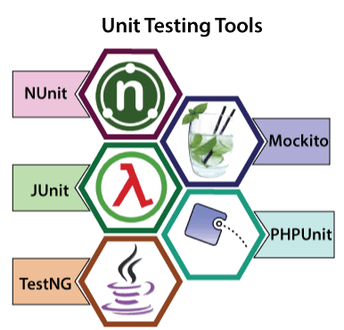
Testing Tools

Slide 13
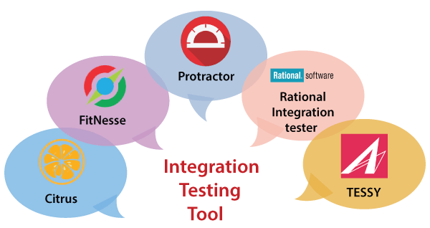
Testing Tools

Slide 14
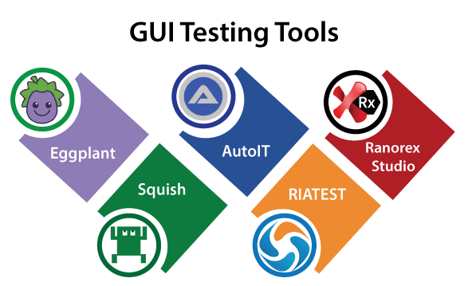
Testing Tools

Slide 15
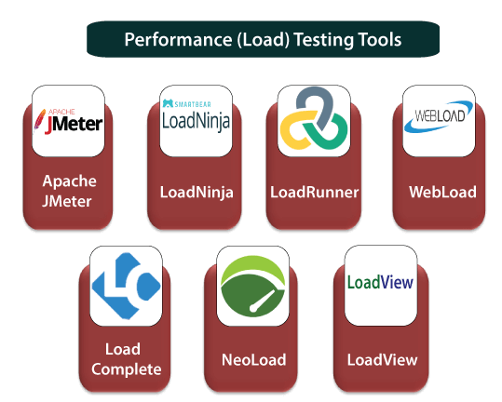
Testing Tools

Slide 16
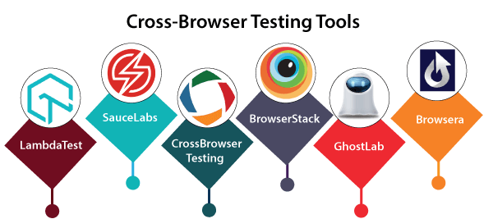
Testing Tools

Slide 17
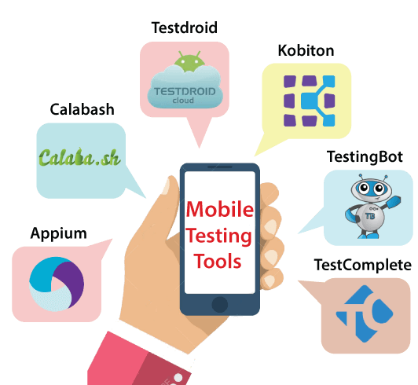
Testing Tools

Slide 18
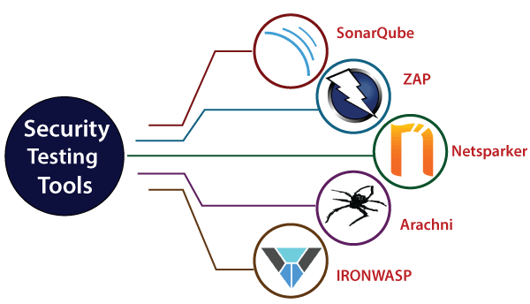
Testing Tools

Slide 19
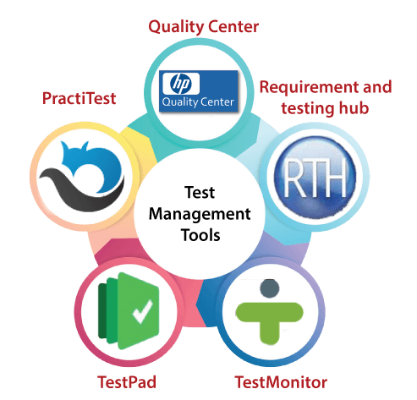
Testing Tools

Slide 20
Testing Documentation

Slide 21
Testing Documentation
Before Testing
Testing starts with test cases generation. Following documents are needed for reference –
SRS document - Functional Requirements document
Test Policy document - This describes how far testing should take place before releasing the product.
Test Strategy document - This mentions detail aspects of test team, responsibility matrix and rights/responsibility of test manager and test engineer.
Traceability Matrix document - This is SDLC document, which is related to requirement gathering process. As new requirements come, they are added to this matrix. These matrices help testers know the source of requirement. They can be traced forward and backward.

Slide 22
Testing Documentation
While Being Tested
The following documents may be required while testing is started and is being done:
Test Case document - This document contains list of tests required to be conducted. It includes Unit test plan, Integration test plan, System test plan and Acceptance test plan.
Test description - This document is a detailed description of all test cases and procedures to execute them.
Test case report - This document contains test case report as a result of the test.
Test logs - This document contains test logs for every test case report.

Slide 23
Testing Documentation
After Testing
The following documents may be generated after testing :
Test summary - This test summary is collective analysis of all test reports and logs. It summarizes and concludes if the software is ready to be launched. The software is released under version control system if it is ready to launch.

Slide 24
Software Quality

Slide 25
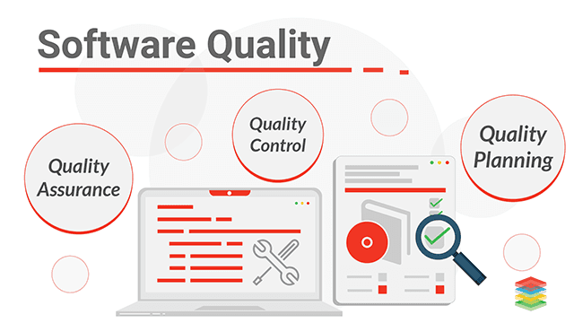
Software Quality
Software Quality
The quality of software can be defined as the ability of the software to function as per user requirement. When it comes to software products it must satisfy all the functionalities written down in the SRS document.

Slide 26
Software Quality
The modern view of a quality associated with a software product several quality methods such as the following:
Portability: A software device is said to be portable, if it can be freely made to work in various operating system environments, in multiple machines, with other software products, etc.
Usability: A software product has better usability if various categories of users can easily invoke the functions of the product.
Reusability: A software product has excellent reusability if different modules of the product can quickly be reused to develop new products.
Correctness: A software product is correct if various requirements as specified in the SRS document have been correctly implemented.
Maintainability: A software product is maintainable if bugs can be easily corrected as and when they show up, new tasks can be easily added to the product, and the functionalities of the product can be easily modified, etc.

Slide 27
Testing vs. QA, QC and Audit
Software quality assurance (QA) -
These are software development process monitoring means, by which it is assured that all the measures are taken as per the standards of organization. This monitoring is done to make sure that proper software development methods were followed.
The responsibility of quality assurance is not of any specific team, but it is a responsibility of each member of the development team.
Quality assurance prevents defects.
Quality assurance is process oriented.
Quality assurance is proactive in a process and preventive in nature.
Quality assurance is a managerial tool.
Each developer is responsible for quality assurance.

Slide 28
Testing vs. QA, QC and Audit
Software quality control (QC) - This is a system to maintain the quality of software product. It may include functional and non-functional aspects of software product, which enhance the goodwill of the organization. This system makes sure that the customer is receiving quality product for their requirement and the product certified as ‘fit for use’.
The responsibility of quality control is of a specific team which is known as a testing team that tests the defects of software by validation and corrective tools.
Quality Control provides identification of defects.
Quality Control is product oriented.
Quality Control is a corrective tool.
Testing team is responsible for Quality control.
Quality Control is a reactive process.

Slide 29
Testing vs. QA, QC and Audit
Points | Quality Assurance (QA) | Quality Control (QC)
Definition | QA is a group of activities which ensures that the quality of processes which is used during the development of the software always be maintained. | QC is a group of activities to detect the defects in the developed software.
Focus | The focus of QA is to prevent defects in the developing software by paying attention to processes. | The focus of QC is to identify defects in the developed software by paying attention to testing processes.
How | Establishment of the high-quality management system and periodic audits for conformance of the operations of the developing software. | Detecting and eliminating the quality problem elements by using testing techniques and tools in the developed software.
What | QA ensures prevention of quality problem elements by using systematic activities including documentation. | QC ensures identification and elimination of defects by using processes and techniques to achieve and maintain high quality of the software.
Orientation | QA is process oriented. | QC is product oriented.
Type of process | QA is a proactive process. It concerns to improve development so; defects do not arise in the testing period. | QC is a reactive process because it concerns to identify defects after the development of product and before its release.
Responsibility | Each and every member of the development team is responsible for QA | Only the specific testing team is responsible for QC
Example | Verification is the example of QA | Validation is the example of QC

Slide 30
Testing vs. QA, QC and Audit
Software audit - This is a review of procedure used by the organization to develop the software. A team of auditors, independent of development team examines the software process, procedure, requirements and other aspects of SDLC. The purpose of software audit is to check that software and its development process, both conform standards, rules and regulations.

Slide 31
ISO 9000 Certification
ISO 9000 Certification
ISO (International Standards Organization) is a group or consortium of 63 countries established to plan and fosters standardization. ISO declared its 9000 series of standards in 1987. It serves as a reference for the contract between independent parties. The ISO 9000 standard determines the guidelines for maintaining a quality system. The ISO standard mainly addresses operational methods and organizational methods such as responsibilities, reporting, etc. ISO 9000 defines a set of guidelines for the production process and is not directly concerned about the product itself.

Slide 32
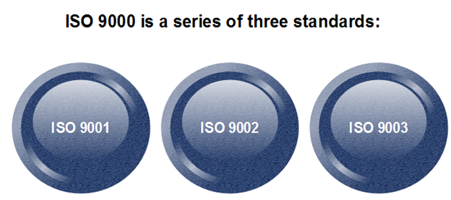
ISO 9000 Certification
Types of ISO 9000 Quality Standards

Slide 33
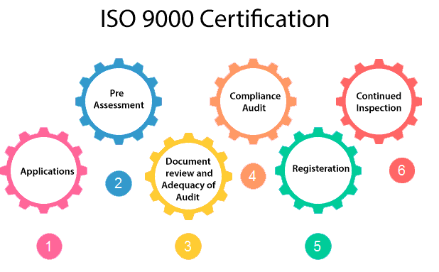
ISO 9000 Certification
How to get ISO 9000 Certification?

Slide 34
ISO 9000 Certification
How to get ISO 9000 Certification?
Application: Once an organization decided to go for ISO certification, it applies to the registrar for registration.
Pre-Assessment: During this stage, the registrar makes a rough assessment of the organization.
Document review and Adequacy of Audit: During this stage, the registrar reviews the document submitted by the organization and suggest an improvement.
Compliance Audit: During this stage, the registrar checks whether the organization has compiled the suggestion made by it during the review or not.
Registration: The Registrar awards the ISO certification after the successful completion of all the phases.
Continued Inspection: The registrar continued to monitor the organization time by time.

Slide 35
Six Sigma
Six Sigma
Six Sigma is the process of improving the quality of the output by identifying and eliminating the cause of defects and reduce variability in manufacturing and business processes. The maturity of a manufacturing process can be defined by a sigma rating indicating its percentage of defect-free products it creates. A six sigma method is one in which 99.99966% of all the opportunities to produce some features of a component are statistically expected to be free of defects (3.4 defective features per million opportunities).

Slide 36
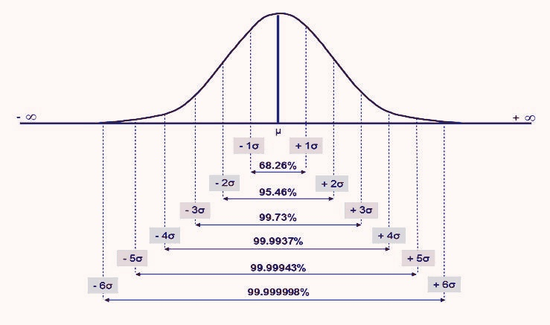
Six Sigma

Slide 37
Six Sigma
Origin of Six Sigma
Six Sigma originated at Motorola in the early 1980s, in response to achieving 10X reduction in product-failure levels in 5 years.
Engineer Bill Smith invented Six Sigma, but died of a heart attack in the Motorola cafeteria in 1993, never knowing the scope of the craze and controversy he had touched off.
Six Sigma is based on various quality management theories (e.g. Deming's 14 point for management, Juran's 10 steps on achieving quality).

Slide 38
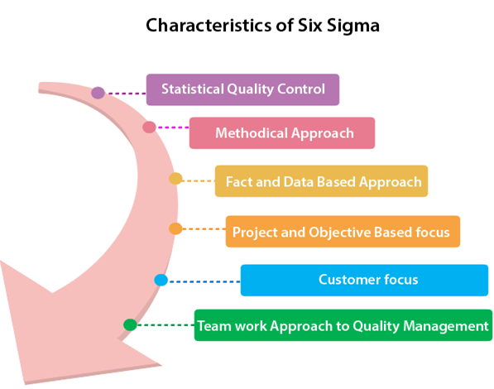
Six Sigma
Characteristics of Six Sigma

Slide 39
Six Sigma
Characteristics of Six Sigma
Statistical Quality Control: Six Sigma is derived from the Greek Letter σ (Sigma) from the Greek alphabet, which is used to denote Standard Deviation in statistics. Standard Deviation is used to measure variance, which is an essential tool for measuring non-conformance as far as the quality of output is concerned.
Methodical Approach: The Six Sigma is not a merely quality improvement strategy in theory, as it features a well defined systematic approach of application in DMAIC and DMADV which can be used to improve the quality of production. DMAIC is an acronym for Design-Measure- Analyze-Improve-Control. The alternative method DMADV stands for Design-Measure- Analyze-Design-Verify.
Fact and Data-Based Approach: The statistical and methodical aspect of Six Sigma shows the scientific basis of the technique. This accentuates essential elements of the Six Sigma that is a fact and data-based.

Slide 40
Six Sigma
Characteristics of Six Sigma
Project and Objective-Based Focus: The Six Sigma process is implemented for an organization's project tailored to its specification and requirements. The process is flexed to suits the requirements and conditions in which the projects are operating to get the best results.
Customer Focus: The customer focus is fundamental to the Six Sigma approach. The quality improvement and control standards are based on specific customer requirements.
Teamwork Approach to Quality Management: The Six Sigma process requires organizations to get organized when it comes to controlling and improving quality. Six Sigma involving a lot of training depending on the role of an individual in the Quality Management team.

Slide 41
Six Sigma
Benefits of Six Sigma
Six Sigma offers six major benefits that attract companies −
Generates sustained success
Sets a performance goal for everyone
Enhances value to customers
Accelerates the rate of improvement
Promotes learning and cross-pollination
Executes strategic change

Slide 42
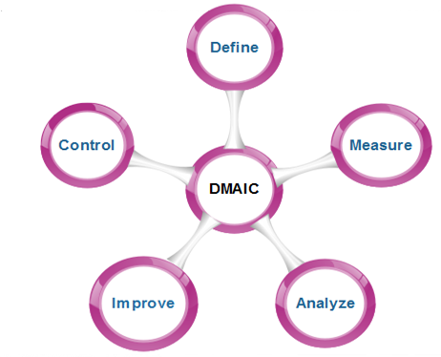
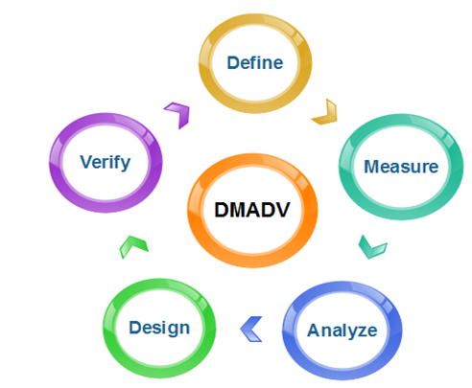
Six Sigma
Six Sigma Methodologies
Six Sigma projects follow two project methodologies:
DMAIC: is used to enhance an existing business process
DMADV: is used to create new product designs or process designs

Slide 43
Software Maintenance

Slide 44
Outlines
Software Maintenance
Need for Maintenance
Types of Software Maintenance
Causes of Software Maintenance Problems
Software Maintenance Cost Factors
Software Re-engineering

Slide 45
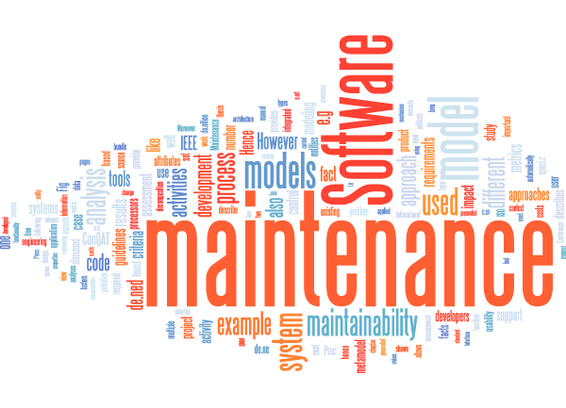
Software Maintenance
Software Maintenance is the process of modifying a software product after it has been delivered to the customer.
The main purpose of software maintenance is to modify and update software application after delivery to correct faults and to improve performance.

Slide 46
Need for Maintenance
Software Maintenance is required to ensure that the system continues to satisfy user requirements:-
Correct errors
Change in user requirement with time
Changing hardware/software requirements
To improve system efficiency
To optimize the code to run faster
To modify the components
To reduce any unwanted side effects.

Slide 47
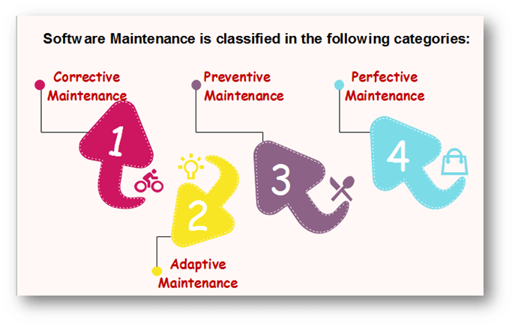
Types of Software Maintenance

Slide 48
Types of Software Maintenance
Maintenance can be divided into the following:
Corrective maintenance: Corrective maintenance of a software product may be essential either to rectify some bugs observed while the system is in use, or to enhance the performance of the system.
Adaptive maintenance: This includes modifications and updates when the customers need the product to run on new platforms, on new operating systems, or when they need the product to interface with new hardware and software.
Perfective maintenance: A software product needs maintenance to support the new features that the users want or to change different types of functionalities of the system according to the customer demands.
Preventive maintenance: This type of maintenance includes modifications and updates to prevent future problems of the software. It goals to attend problems, which are not significant at this moment but may cause serious issues in future.

Slide 49
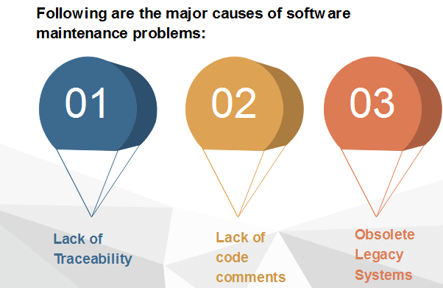
Causes of Software Maintenance Problems

Slide 50
Causes of Software Maintenance Problems
Lack of Traceability
Codes are rarely traceable to the requirements and design specifications.
It makes it very difficult for a programmer to detect and correct a critical defect affecting customer operations.
Like a detective, the programmer pores over the program looking for clues.
Life Cycle documents are not always produced even as part of a development project.
Lack of Code Comments
Most of the software system codes lack adequate comments. Lesser comments may not be helpful in certain situations.

Slide 51
Causes of Software Maintenance Problems
Obsolete Legacy Systems
In most of the countries worldwide, the legacy system that provides the backbone of the nation's critical industries, e.g., telecommunications, medical, transportation utility services, were not designed with maintenance in mind.
They were not expected to last for a quarter of a century or more.
As a consequence, the code supporting these systems is devoid of traceability to the requirements, compliance to design and programming standards and often includes dead, extra and uncommented code, which all make the maintenance task next to the impossible.

Slide 52
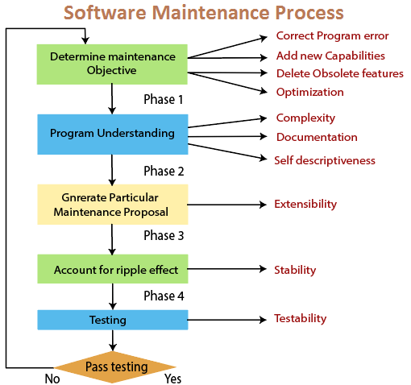
Causes of Software Maintenance Problems

Slide 53
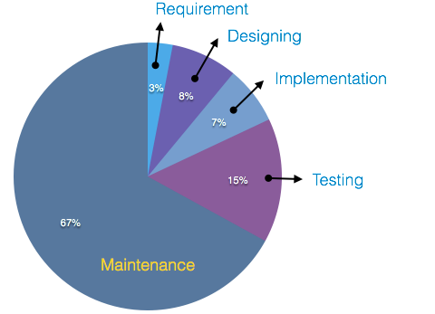
Software Maintenance Cost Factors
A study on estimating software maintenance found that the cost of maintenance is as high as 67% of the cost of entire software process cycle.
There are two types of cost factors involved in software maintenance.
These are
Non-Technical Factors
Technical Factors

Slide 54
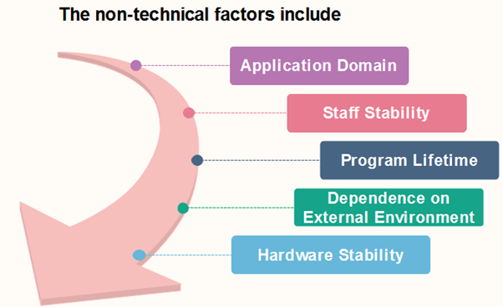
Software Maintenance Cost Factors

Slide 55
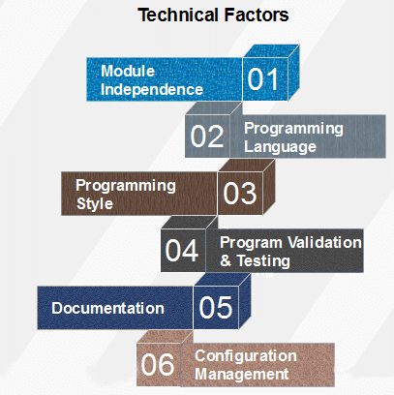
Software Maintenance Cost Factors

Slide 56
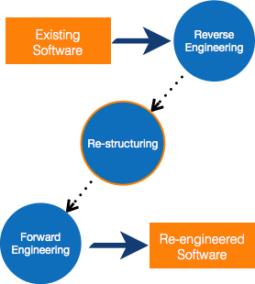
Software Re-engineering
When we need to update the software to keep it to the current market, without impacting its functionality, it is called software re-engineering. It is a thorough process where the design of software is changed and programs are re-written.

Slide 57

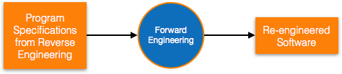
Re-Engineering Process
Reverse Engineering Reverse Engineering is processes of extracting knowledge or design information from anything man-made and reproducing it based on extracted information. It is also called back Engineering.
Forward Engineering
Forward engineering is a process of obtaining desired software from the specifications in hand which were brought down by means of reverse engineering. It assumes that there was some software engineering already done in the past.

Slide 58
Re-Engineering Process
Why Reverse Engineering?
Providing proper system documentation.
Recovery of lost information.
Assisting with maintenance.
Facility of software reuse.
Discovering unexpected flaws or faults
Used of Software Reverse Engineering –
Software Reverse Engineering is used in software design, reverse engineering enables the developer or programmer to add new features to the existing software with or without knowing the source code.
Reverse engineering is also useful in software testing, it helps the testers to study the virus and other malware code .

Slide 59

Thanks to All

